Slide 1
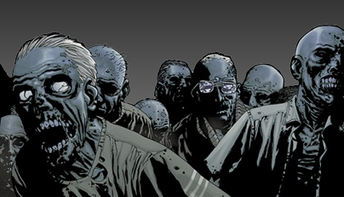
Zombie Culture

Slide 2
Free Write
“Zombies” may not be real—but the state of ‘living death’ might be. Think about how zombies are represented; now brainstorm all the real-life phenomena that might be related to zombies in some way. What are some real-life things zombies are related to? What do they remind you of?
Come up with as many ideas as you can.

Slide 3
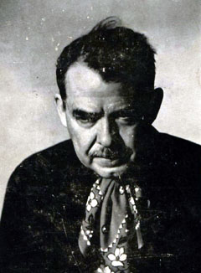
W. B. Seabrook
1884-1945
American journalist
“Lost Generation”
Wrote about:
Participating in “black magic” / occult rites
Time spent in psychiatric ward for alcoholism
Practicing S&M
Cannibalism
The Magic Island (1929)
In English, 1st account of “zombies”

Slide 4
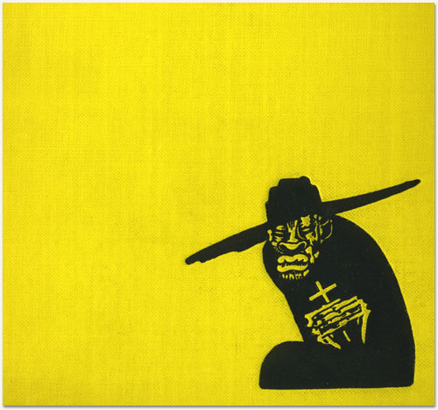
The Magic Island
By W.B. Seabrook
1929
Travelogue (Haiti)
“Dead Men Working in the Cane Fields”
12pp of 336pp
Illustrated by Alexander King

Slide 5
Seabrook, The Magic Island
“It seemed . . . that while the zombie came from the grave, it was neither a ghost nor yet a person who had been raised like Lazarus from the dead. The zombie, they say, is a soulless human corpse, still dead, but taken from the grave and endowed by sorcery with a mechanical semblance of life—it is a dead body which is made to walk and act and move as if it were alive. People who have the power to do this go to a fresh grave, dig up the body before it has had time to rot, galvanize it into movement, and then make of it a servant or slave, occasionally for the commission of some crime, more often simply as a drudge around the habitation or the farm, setting it dull heavy tasks, and beating it like a dumb beast if it slackens.”

Slide 6
Seabrook, The Magic Island
“One morning an old black headman, Ti Joseph of Colombier, appeared leading a band of ragged creatures who shuffled along behind him, staring dumbly, like people walking in a daze. As Joseph lined them up for registration, they still stared, vacant-eyed like cattle, and made no reply when asked to give their names.
Joseph said they were ignorant people from the slopes of Morne-au-Diable, a roadless mountain district near the Dominican border, and that they did not understand the creole of the plains. They were frightened, he said, by din and smoke of the great factory, but under his direction they would work hard in the fields. . . . For these were not living men and women but poor unhappy zombies whom Joseph and his wife Croyance had dragged from their peaceful graves to slave for him in the sun.”

Slide 7
Signal Question
What is ‘monstrous’ about Seabrook’s zombies? How do they differ from current popular representations of zombies? Significant similarities or differences?
Seabrook is writing a “travel book”—not horror fiction. Regarding the zombies, he seems to waver between skepticism and belief. Do you think he “believes in” zombies? What effect does he want to produce in his readers? Pay attention to his language and rhetoric.

Slide 8
Close Read
“…[T]here was something about them unnatural and strange. They were plodding like brutes, like automatons. . . . The eyes were the worst. . . . They were in truth like the eyes of a dead man, not blind, but staring, unfocused, unseeing. The whole face . . . . was vacant, as if there was nothing behind it.”

Slide 9
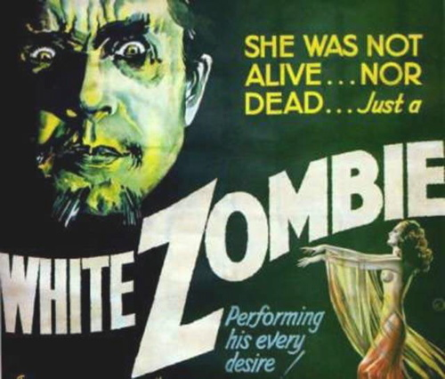
White Zombie
Directed by Victor & Edward Halperin
Based (in part) on The Magic Island
1932
Starring Béla Lugosi
Trailer

Slide 10
Signal Question
How would you compare this scene from White Zombie with Seabrook’s text? What happens when the travelogue is turned into a horror movie?

Slide 11
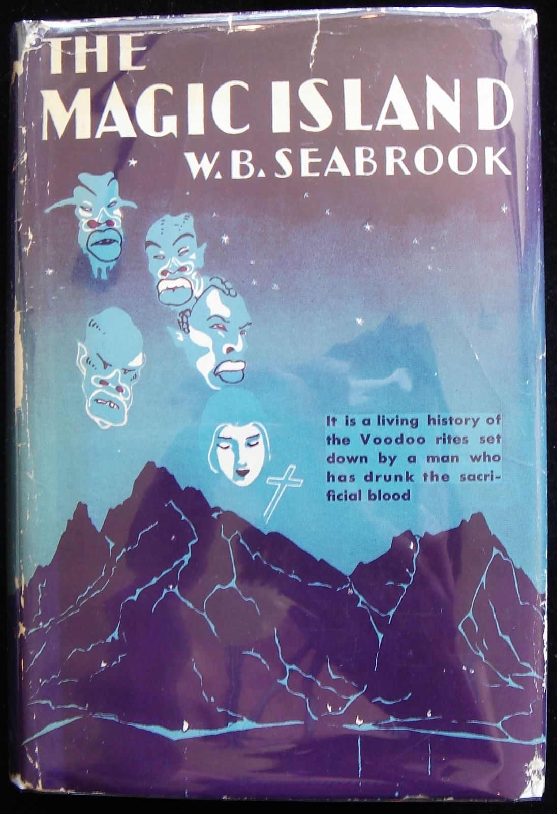
Seabrook on Vodou
“Vodou” (voodoo, vodun, etc.): In Haiti, a syncretic religion (composed of beliefs from originally distinct belief systems)
Seabrook attempted to learn and write about Haitian vodou
Editor: ‘No white man can write a good book about voodoo.’
Seabrook shows how hard he worked to learn well-kept secret,
Details where he finds info
“a living history of the Voodoo rites set down by a man who has drunk the sacrificial blood”

Slide 12
The Magic Island - Vodou
“And now the literary-traditional white stranger who spied from hiding in the forest, had such a one lurked near by, would have seen all the wildest tales of Voodoo fiction justified: in the red light of torches which made the moon turn pale, leaping, screaming, writhing black bodies, blood-maddened, sex-maddened, god-maddened, drunken, whirled and danced their dark saturnalia, heads thrown weirdly back as if their necks were broken, white teeth and eyeballs gleaming, while couples seizing one another from time to time fled from the circle, as if pursued by furies, into the forest to share and slake their ecstasy. . .”

Slide 13
The Magic Island - Vodou
“I did not experience the revulsion which literary tradition prescribes. It was savage and abandoned, but it seemed to me magnificent and not devoid of a certain beauty. Something inside myself awoke and responded to it. These, of course, were very individual emotional reactions, perhaps deplorable in a supposedly civilized person. But I believe that the thing itself - their thing, I mean - is rationally defensible. Of what use is any life without its emotional moments or hours of ecstasy? They were reaching collective ecstasy by paths which were not intrinsically peculiar to their jungle ancestors, but which have been followed by many peoples, some highly civilized, from the earliest ages, and will be followed to the end of time or until we all become mechanical, soulless robots. . . .”

Slide 14
The Magic Island - Vodou
“What, after all, were they doing here in these final scenes, when formal ritual had ended, that was so different from things which occur in our own fashionable and expensive night clubs, except that they were doing it with the sanction of their gods and were doing it more successfully? Savage rhythm, alcohol, and sex excitement - yet there was an essential difference, for here was a mysterious something superadded. Lasciviousness became lust, which is a cleaner thing, and neurotic excitement became authentic ecstasy, the 'divine frenzy' of the ancients.”

Slide 15
Signal Question
How would you describe Seabrook’s attitude towards voodoo? How would you describe his language use here? How would you compare these passages to his account of zombies?

Slide 16
Intention
As Joe Ollman reports in his Foreward to a recent edition of The Magic Island, Seabrook reportedly prayed (in a vodou ceremony): “Protect me from misrepresenting these people, and give me the power to write honestly of their mysterious religion, for all living faiths are sacred.”
He was also offered an enormous sum of money to serialize The Magic Island in a magazine, if he agreed to allow them to make extensive edits. He refused.

Slide 17
“Primitivism”
2 a : belief in the superiority of a simple way of life close to nature
2 b : belief in the superiority of nonindustrial society to that of the present
Conventionally: The romanticization of nonindustrial (usually nonwhite) people and cultures—often involving stereotypes emphasizing sex, violence, animality

Slide 18
“Exoticism”
“Exoticism”:
the quality of being unusual and exciting because of coming (or seeming to come) from far away, especially a tropical country

Slide 19
Signal Question
Is Seabrook’s depiction of zombies “primitivist” or “exoticized”? What about his depiction of vodou?
Does his defense of vodou mitigate the potential stereotypes or exoticism of his portrayal? Is monstrosity relevant to this discussion?

Slide 20
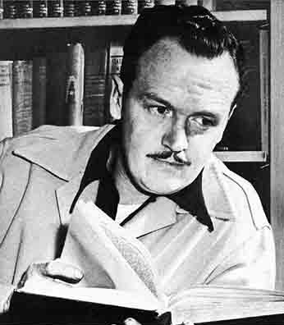
Alexander King
1899-1965
Illustrator, Writer, TV “Personality”
Illustrated The Magic Island
TIME magazine:
"an ex-illustrator, ex-cartoonist, ex-adman, ex-editor, ex-playwright, ex-dope addict. For a quarter-century he was an ex-painter, and by his own bizarre account qualifies as an ex-midwife. He is also an ex-husband to three wives and an ex-Viennese of sufficient age (60) to remember muttonchopped Emperor Franz Joseph. When doctors told him a few years ago that he might soon be an ex-patient (two strokes, serious kidney disease, peptic ulcer, high blood pressure), he sat down to tell gay stories of the life of all these earlier Kings."

Slide 21
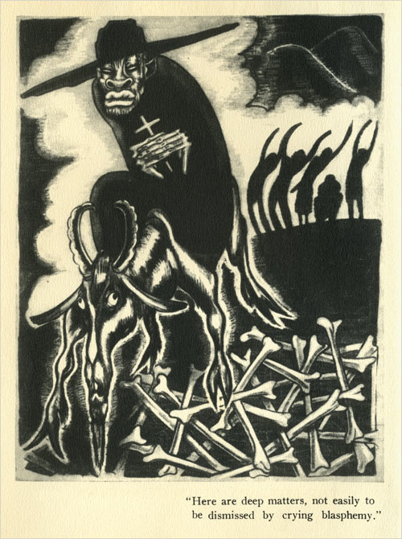
Illustration, Alexander King

Slide 22
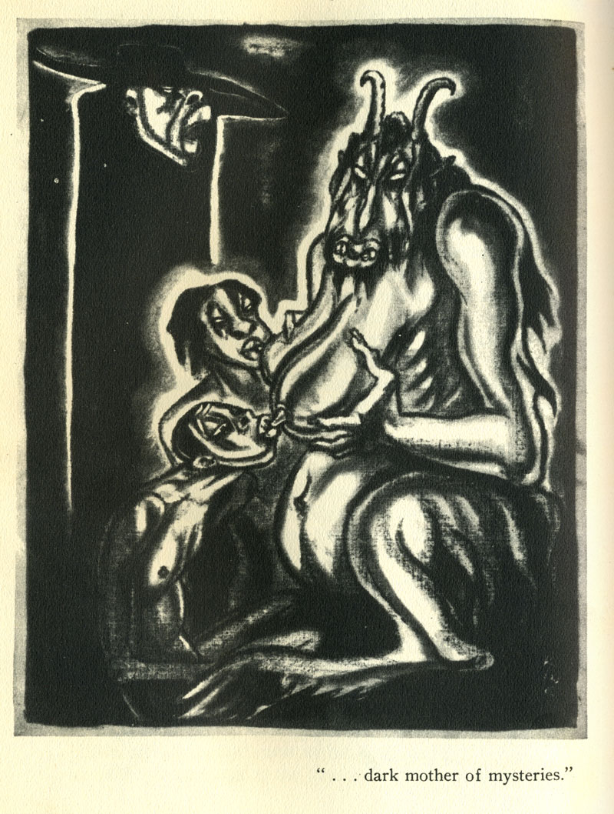
Illustration, Alexander King

Slide 23
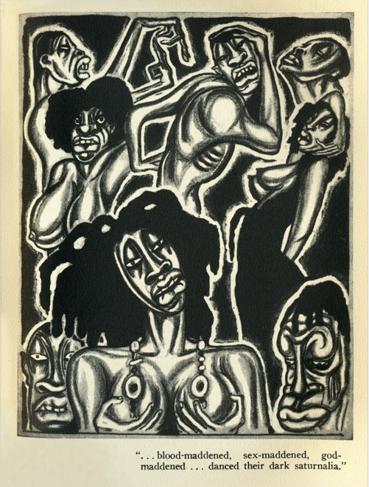
Illustration, Alexander King

Slide 24
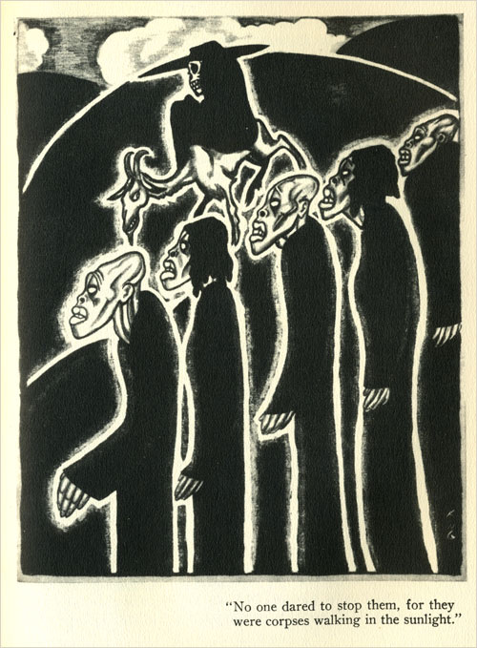
Illustration, Alexander King

Slide 25
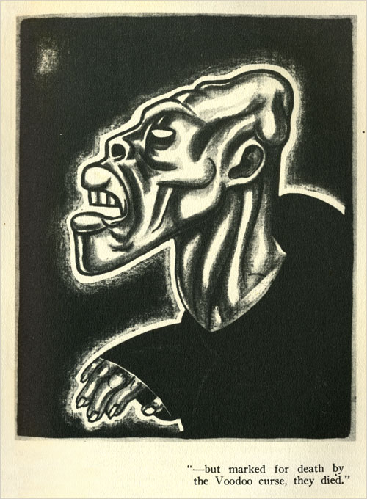
Illustration, Alexander King

Slide 26
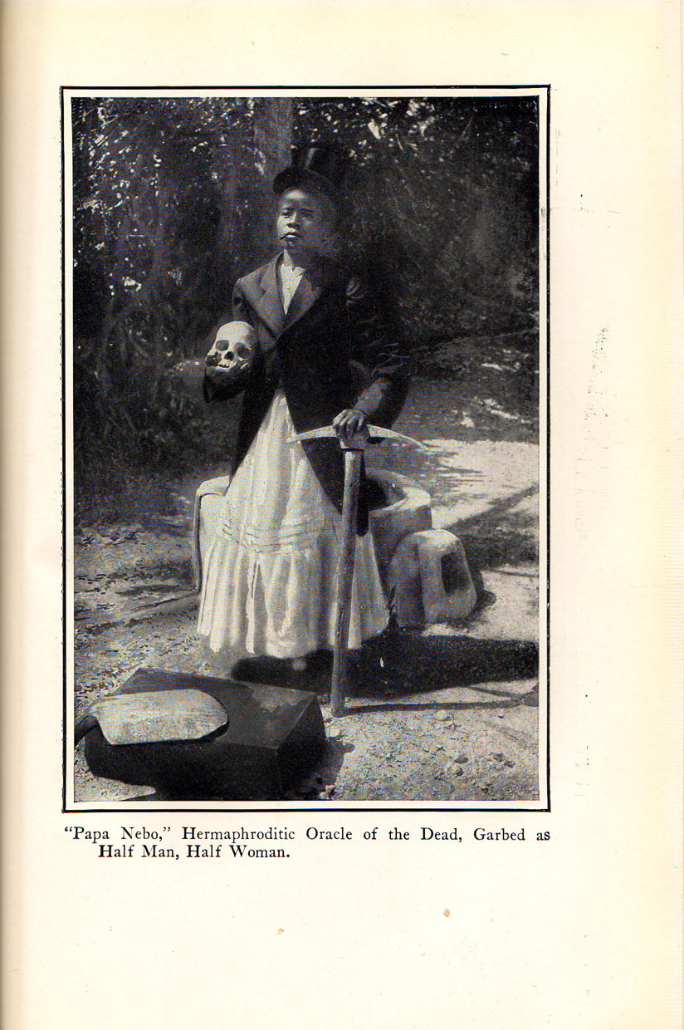
Photograph,
W.B. Seabrook

Slide 27
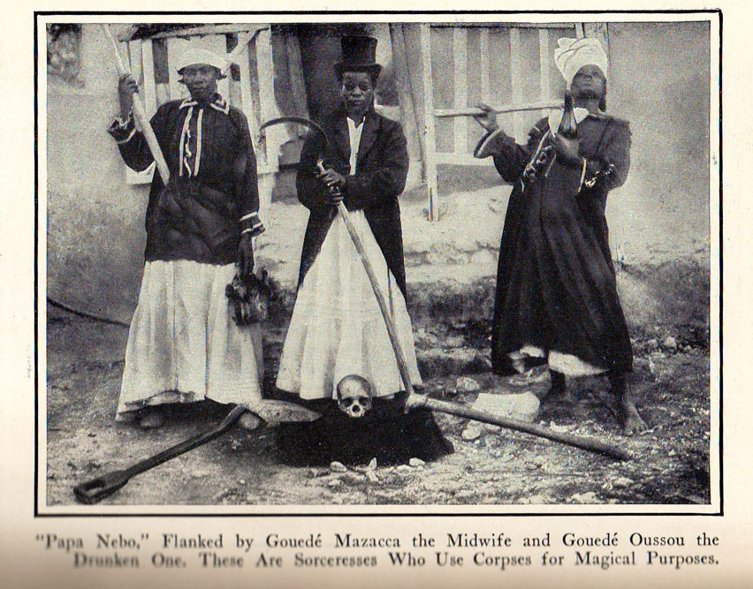
Photograph,
W.B. Seabrook

Slide 28
Signal Question
Consider the passages we read from Seabrook’s The Magic Island, as well as the illustrations and photographs included in that work. What kinds of “monstrosity” do you see there? How is racial difference represented? Does the presence of the photographs and illustrations alter the significance of the text?
Recall these three theses of Cohen’s:
The Monster’s Body Is a Cultural Body
The Monster Dwells at the Gates of Difference
Fear of the Monster is Really a Kind of Desire
How might any one of these relate to the above texts?

Slide 29
Cannibalism (?)
On the taste of human flesh:
“It was like good, fully developed veal, not young, but not yet beef. It was very definitely like that, and it was not like any other meat I had ever tasted. It was so nearly like good, fully developed veal that I think no person with a palate of ordinary, normal sensitiveness could distinguish it from veal. It was mild, good meat with no other sharply defined or highly characteristic taste such as for instance, goat, high game, and pork have. The steak was slightly tougher than prime veal, a little stringy, but not too tough or stringy to be agreeably edible. The roast, from which I cut and ate a central slice, was tender, and in color, texture, smell as well as taste, strengthened my certainty that of all the meats we habitually know, veal is the one meat to which this meat is accurately comparable.”
From W.B. Seabrook, Jungle Ways (1930)

Slide 30
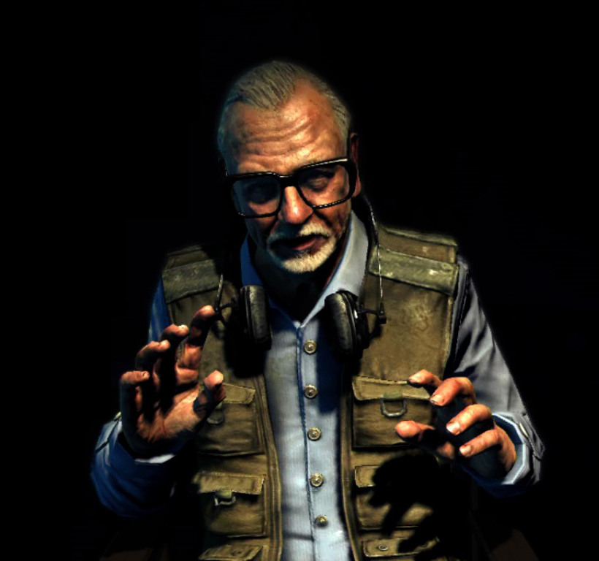
George A. Romero
American-Canadian film director
Born 1940
Wrote/Directed:
Night of the Living Dead (1968, 1990)
Dawn of the Dead (1978)
Day of the Dead (1985)

Slide 31
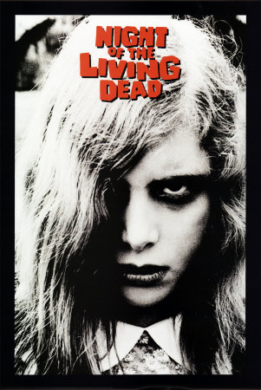
Dir. George Romero
1968
$114,000 budget (orig. $6,000)
$12 Million domestic
Controversial reception, Eventual critical acclaim

Slide 32
Reception
“Until the Supreme Court establishes clear-cut guidelines for the pornography of violence, Night of the Living Dead will serve nicely as an outer-limit definition by example. In [a] mere 90 minutes this horror film (pun intended) casts serious aspersions on the integrity and social responsibility of its Pittsburgh-based makers, distributor Walter Reade, the film industry as a whole and [exhibitors] who book [the picture], as well as raising doubts about the future of the regional cinema movement and about the moral health of film goers who cheerfully opt for this unrelieved orgy of sadism...”
–Variety (1968)

Slide 33
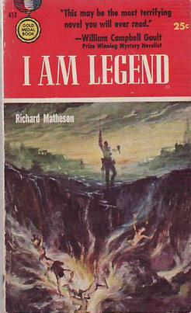
Inspiration
Inspired by Richard Matheson’s novel I Am Legend (1954)
The Last Man on Earth (1964); The Omega Man (1971); I Am Legend (2007)
Beginning of apocalyptic scenario (rather than end)
Flesh-eating reanimated corpses (rather than vampires)

Slide 34
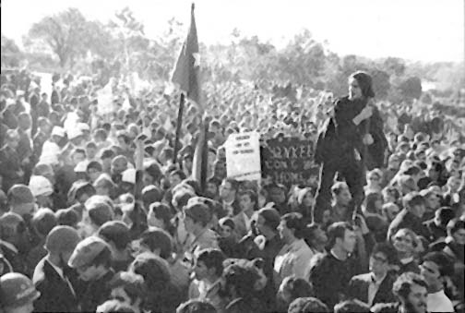
Context
April, 1968: Assassination of Martin Luther King, Jr.
June, 1968: Assassination of Robert F. Kennedy
Vietnam War / Anti-war protests
Civil Rights protests
Student protests

Slide 35
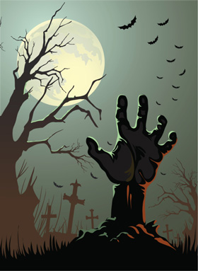
Breaking Ground
Low budget, massive profit
Black hero
Use of noir aesthetics in horror
“Everyday” setting (vs. mansion, castle, Victorian gothic)
Introduction of gore
“The movie had stopped being delightfully scary about halfway through, and had become unexpectedly terrifying.” –Roger Ebert
Unhappy ending

Slide 36
Subverting Horror Conventions
“The woman who appears to be established as the heroine becomes virtually catatonic early in the film and remains so to the end; no love relationship develops between her and the hero. The young couple whose survival as future nuclear family is generically guaranteed is burned alive and eaten around the film’s midpoint. The film’s actual nuclear family is wiped out; the child (a figure hitherto sacrosanct) not only dies but comes back as a zombie, devours her father, and hacks her mother to death. In a final devastating stroke, the hero of the film and sole survivor of the zombies (among the major characters) is callously shot down by a sheriff’s posse, thrown on a bonfire, and burned.” –Robin Wood

Slide 37
Signal Question
How do the zombies (or “living dead”) in Romero’s film compare with those described by Seabrook? What resemblances can you identify? In what specific ways are Romero’s zombies “monstrous”?

Slide 38
Signal Question
Set in a farmhouse, Night portrays several types of social relations: brother/sister, heterosexual couple, nuclear family. It also hints at the possibility of others (interracial couples, incest). How are these relations portrayed? Do they have any relation to monstrosity? What role do the zombies play here, if any?

Slide 39
Signal Question
Think about the context of the film (the late 1960s). How might we think about this film historically? If “the monster’s body is a cultural body,” what does Night of the Living Dead have to say about the culture it emerged from?

Slide 40
Zombies as "Symptoms"
In Night of the Living Dead, the zombies have been interpreted as representing:
Communists
White lynch mob
Vietcong
Dead Vietnamese
All of us / anybody
Romero: "The neighbors"

Slide 41
The Slap (or Punch)
The scene in which Barbra slaps Ben, and is punched by him in return, was the cause of significant controversy in the film. What's your reading of that scene, and the power dynamics and social identities (race and gender) involved? What do you think of the film's representation of gender roles? Any relation to monstrosity?

Slide 42
Signal Question
Much has been made of the fact that Night’s protagonist is black. Romero says the character was written without race in mind, and that the casting of Duane Jones was based on merit alone. Many have praised the film for not commenting explicitly on his race. Yet many also believe the film—especially its ending—has something important to say about race. What do you think?

Slide 43
"Ben"
[Presumably white] Original Ben: “Don’t you mind the creep outside. I can handle him. There’s probably gonna be lots more of ‘em. Soons they fin’ out about us. Ahm outa gas. Them pumps over there is locked. Is there food here? Ah get us some grub. Then we beat ‘em off and skedaddle. Ah guess you putzed with the phone.”

Slide 44
"Ben"
Duane Jones as Ben: “Don’t worry about him. I can handle him. Probably be a whole lot more of them when they find out about us. The truck is out of gas. The pump out here is locked — is there a key? We can try to get out of here if we get some gas. Is there a key?” [Ben tries the phone.] “‘Spose you’ve tried this. I’ll see if I can find some food.”

Slide 45
Critical Reading
“Romero uses [the blackness of the hero] to signify his difference from the other characters, to set him apart from their norms. He alone has no ties. . . . From this arises the significance of two events at the end of the film: he survives the zombies, and he is shot down by the posse. It is the function of the posse to restore the social order that has been destroyed; the zombies represent the suppressed tensions and conflicts—the legacy of the past, of the patriarchal structuring of relationships, ‘dead’ yet automatically continuing—which that order creates and on which it precariously rests.” –Robin Wood

